Slide 1
Regression Losses and Learning Rates

Slide 2


Loss Functions

Slide 3
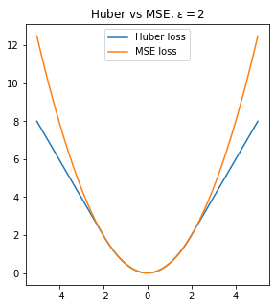
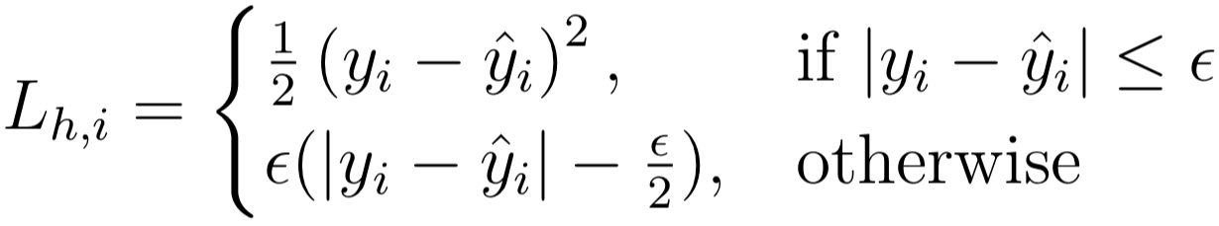
Losses
Huber
Epsilon insensitive
Squared epsilon insensitive
Huber
Epsilon insensitive
Squared epsilon insensitive
Notes:
Photo: https://www.flickr.com/photos/107442568@N08/12547327134

Slide 4
Losses
Huber
Epsilon insensitive
Squared epsilon insensitive
Notes:
Photo: https://www.flickr.com/photos/107442568@N08/12547327134

Slide 5
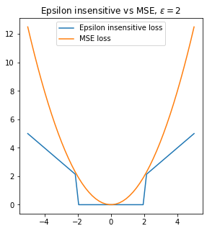
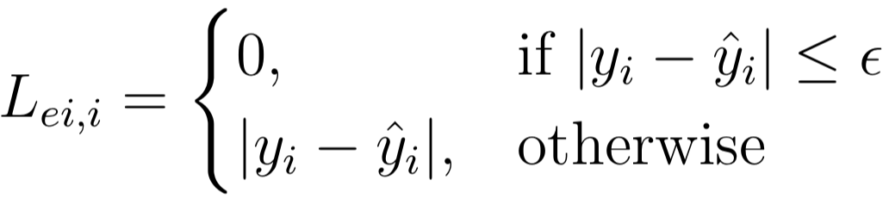
Losses
Huber
Epsilon insensitive
Squared epsilon insensitive
Notes:
Photo: https://www.flickr.com/photos/107442568@N08/12547327134

Slide 6
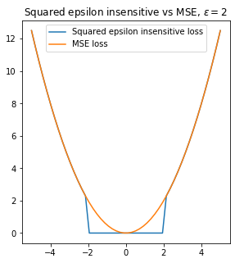
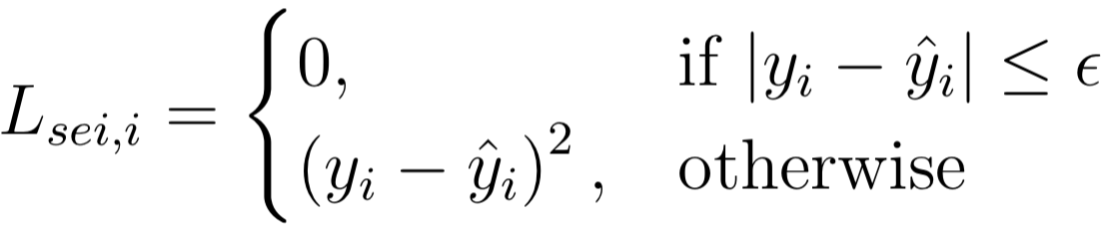
Losses
Huber
Epsilon insensitive
Squared epsilon insensitive
Notes:
Photo: https://www.flickr.com/photos/107442568@N08/12547327134

Slide 7
Learning Rates

Slide 8
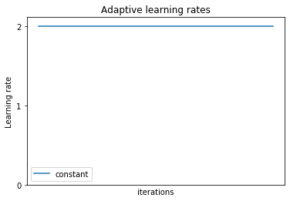

Learning Rates
Constant

Slide 9
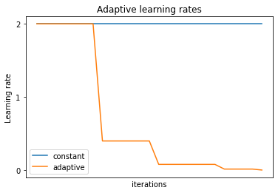

Learning Rates
Constant
Adaptive
When loss hasn’t changed for last i iterations, update learning rate

Slide 10
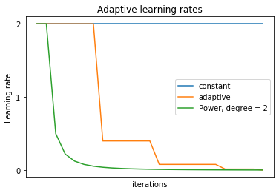

Learning Rates
Constant
Adaptive
Power

Slide 11
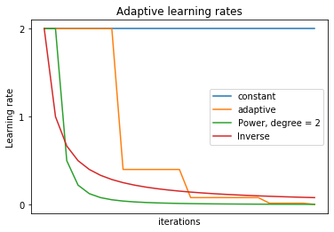

Learning Rates
Constant
Adaptive
Power
Inverse

